Slide 1


Sepsis Pathophysiology Spooktacular
Marie Mullen MD
Department of Emergency Medicine
Division of Pulmonary and Critical Care Medicine
Horror Movie Survival: Avoid all motels that are not part of giant international chains

Slide 2

Disclosures
I have no actual or potential conflict of interest in relation to this program/ presentation. Except…

Slide 3

Getting to the Point
Sepsis-Life-threatening organ dysfunction caused by a dysregulated host response to infection
Organ dysfunction is an integral part of sepsis
Pathophysiology of organ dysfunction similar for organs involved
Restore and maintain adequate oxygen delivery to cells
Limit organ dysfunction by rapid control of infection, hemodynamic stabilization /organ support as possible to ensure recovery of organ function

Slide 4

Fighting Back
SURVIVING SEPSIS CAMPAIGN BUNDLES
TO BE COMPLETED WITHIN 3 HOURS:
1) Measure lactate level
2) Obtain blood cultures prior to administration of antibiotics
3) Administer broad spectrum antibiotics
4) Administer 30 mL/kg crystalloid for hypotension or lactate 4mmol/L

Slide 5
Fighting Back
SURVIVING SEPSIS CAMPAIGN BUNDLES
TO BE COMPLETED WITHIN 6 HOURS:
5) Apply vasopressors (for hypotension that does not respond to initial fluid resuscitation) to maintain a mean arterial pressure (MAP) 65 mm Hg
6) In the event of persistent arterial hypotension despite volume resuscitation (septic shock) or initial lactate 4 mmol/L : re-assess volume status and tissue perfusion
7) Remeasure lactate if initial lactate was elevated

Slide 6

Rogues’ Gallery
Cardiovascular
Pulmonary
Renal
Hematologic
Cerebral
Gastrointestinal
Endocrine

Slide 7
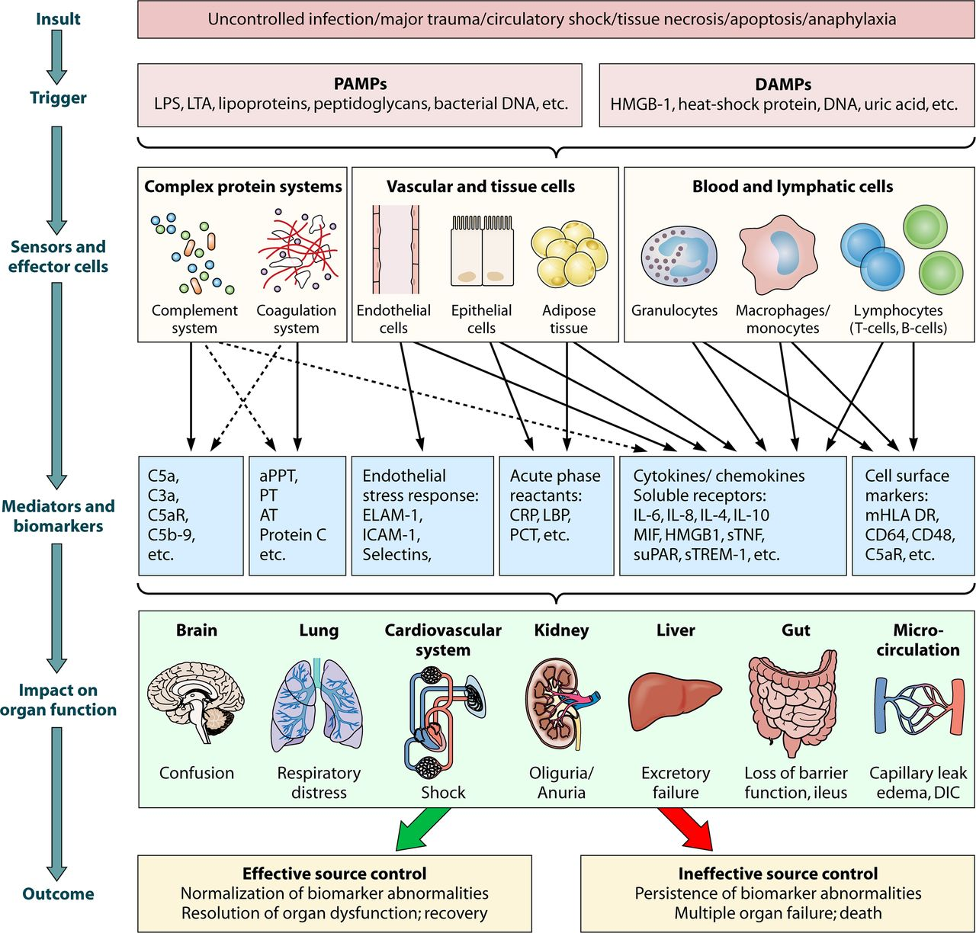

Don’t Scream

Slide 8

Seeing Red
Cardiovascular
Hypotension
  Vasodilation- IL-1, TNF, iNOS
  Myocardial Dysfunction-IL-1, TNF
  Volume Depletion
Autonomic Dysregulation
Lactic Acidosis

Slide 9
Seeing Red
Cardiovascular

Slide 11
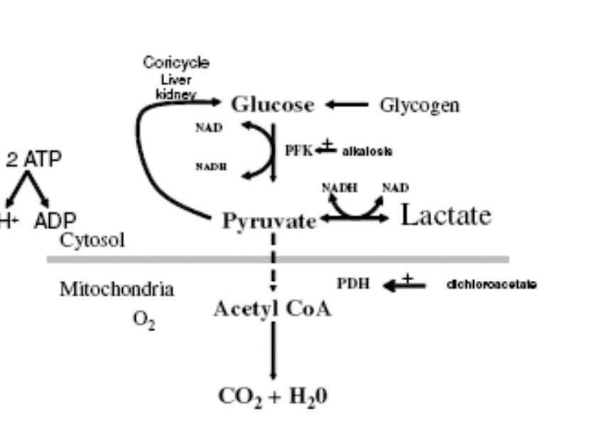

Slide 12

Stopping the Bleed
  Serial reassessment
  Fluid challenge
  Passive leg raise
Fluid resuscitation with guidance
  Ultrasound/echo
  CVP
Vasopressors
  Norepinephrine
  Epinephrine
  Vasopressin (endocrine)
Inotropes
  Dobutamine
Serial Lactic Acid
  ScVO2

Slide 13

Future Directions
Beta Blockade
  Morelli A, et al Effect of Heart Rate Control With Esmolol on Hemodynamic and Clinical Outcomes in Patients With Septic Shock A Randomized Clinical Trial. JAMA 2013;310(16):1683-1691
Methylene Blue
  Kwok ES, Howes, D. (2006). Use of Methylene Blue in Sepsis: A Systematic Review. Journal of Intensive Care Medicine, 21(6), 359–363

Slide 14
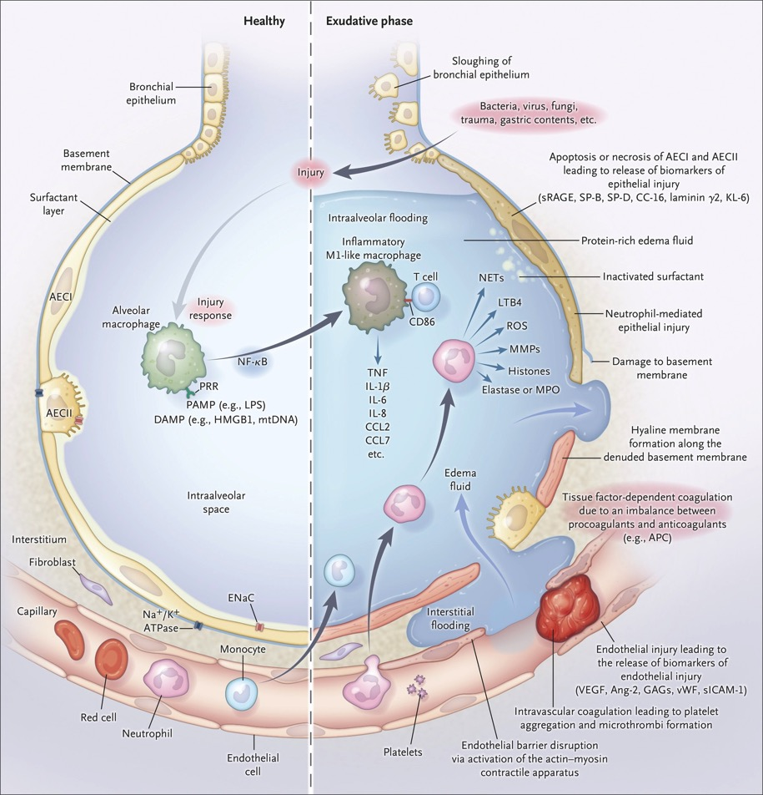
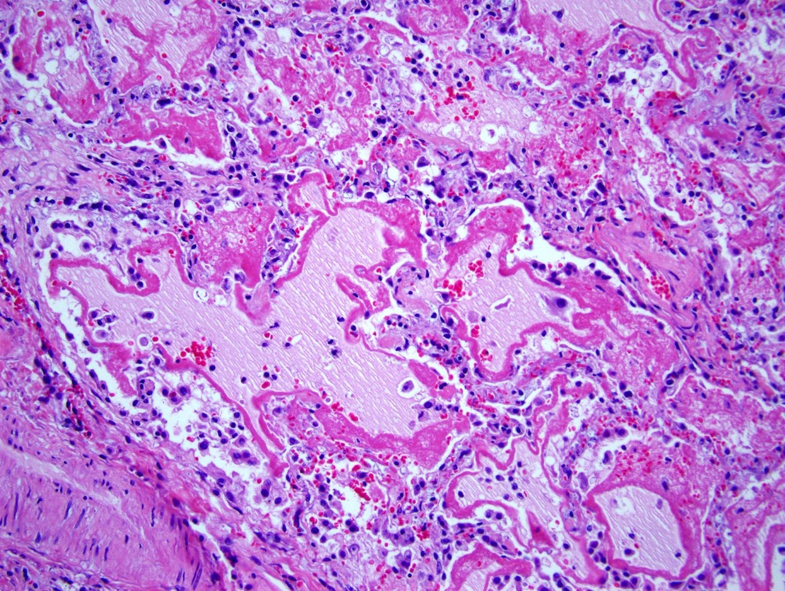
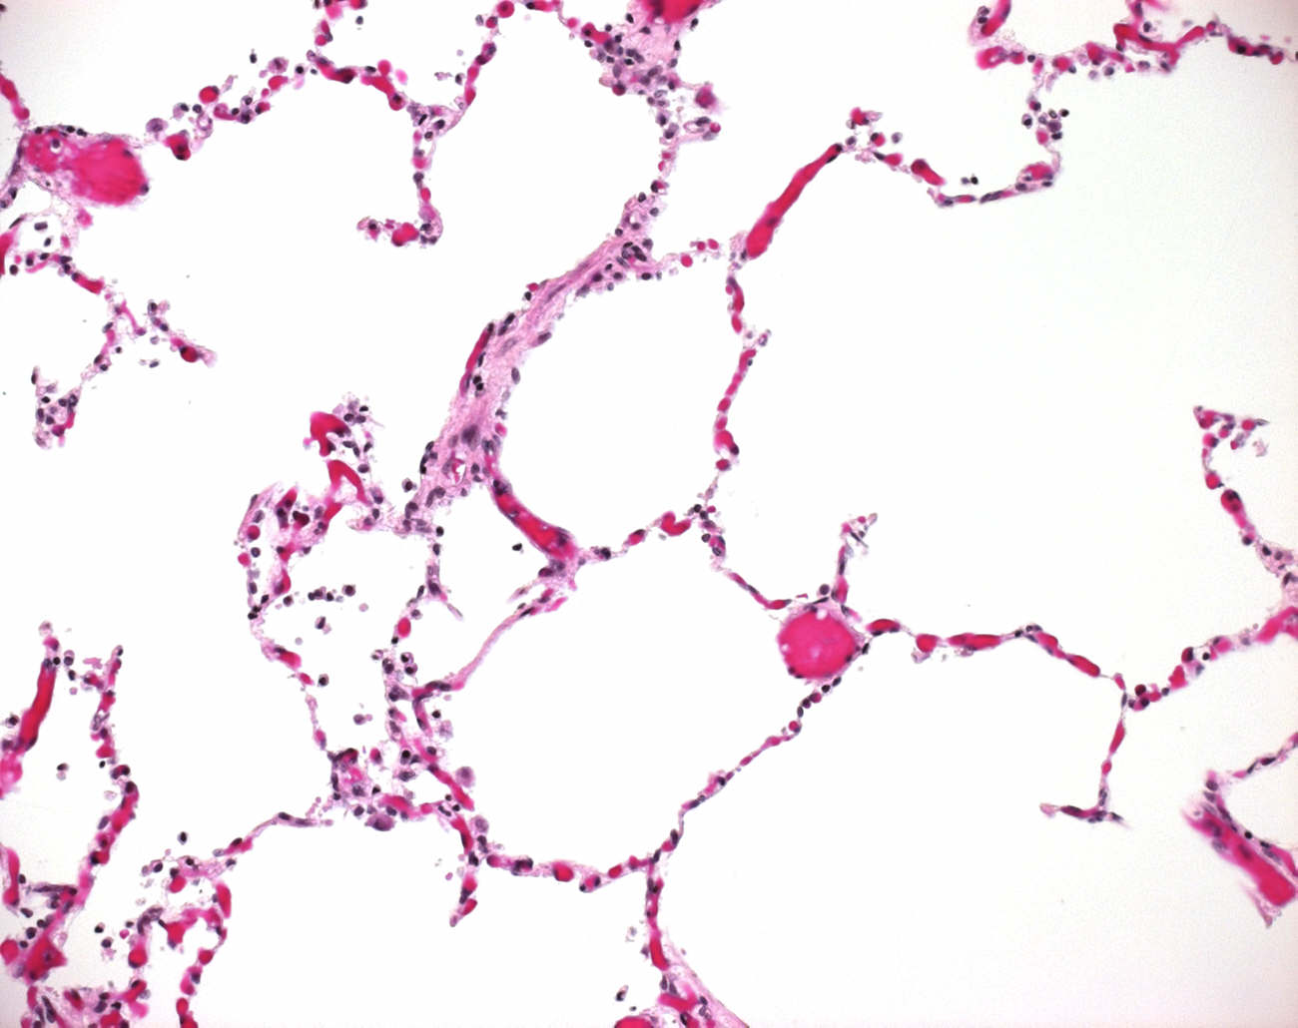

Take a Deep Breath
Pulmonary
Damage to the pulmonary capillary membrane
Increased permeability of capillary membrane
Protein rich edema fluid and inflammatory cell influx
Surfactant dysfunction/inhibition-multifactorial
Decreased compliance
Hypoxia/ microthrombi related pulmonary hypertension
Horror Movie Survival: If you are babysitting, never ever answer the phone.

Slide 15

No Prisoners
Lung protective ventilation- 6/ml/kg PBW TV
Plateau pressure less than 30 mm H2O
Higher PEEP strategy preferred
Prone over supine position with RDS and P/F < 150
NMBAs for ≤ 48 hours in patients with ARDS and P/F < 150
Controversial- Steroids in early ARDS-NEVER after 14 days
Consider inhaled pulmonary vasodilators
ECMO in selected patients
Horror Movie Survival: When taking on the living dead, dress for success
Notes:
Aspirin
Beta agonists
Mesenchymal cells

Slide 16

Adding to the Nightmare
Renal
Renal blood flow is not decreased in septic shock
May be an issue of gradient of flow between afferent/afferent
Cannot maintain pressure in glomerulus
Afferent vasocontraction may be chloride medicated
Tubular lumen obstruction with debris
Glomerular cell permeability limiting filtration
Not ischemia- inflation/microcirculation
Horror Movie Survival: Don’t Ever Say I’ll Be Right Back--You Won’t

Slide 17

Batter UP
Limit high chloride fluids-prefer balance
SALT-ED and SMART (2018)
Norepinephrine- improved renal blood flow, urine output, and glomerular filtration
Vasopressin- vasoconstricts the efferent arteriole, linked to less dialysis
Avoid NSAIDs, ACE-I and ARB
Possible use for angiotensin II
RRT for AKI when appropriate/Hemoperfusion not validated
Self WH, Semler MW, Wanderer JP, et al. Balanced crystalloids versus saline in noncritically ill adults. N Engl J Med 2018;378:819-828
Semler MW, Self WH, Wanderer JP, et al. Balanced crystalloids versus saline in critically ill adults. N Engl J Med 2018;378:829-839

Slide 18

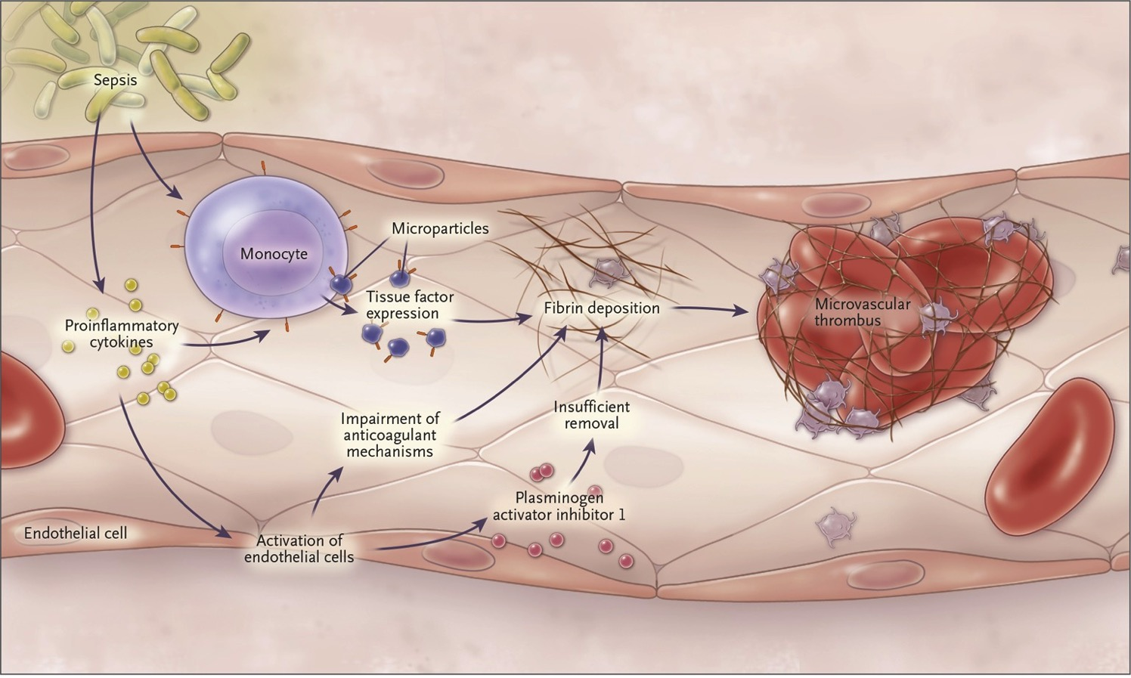
Here’s Blood in your eye
Hematologic
All cell lines affected
Decreased red cell deformability-decrease RBC membrane function
Anemia-growth inhibition and hemolysis
Elevated or depleted neutrophils
Thrombocytopenia- platelet adhesion/direct immune related destruction/decreased production
Hypercoagulable state- upregulate procoagulant pathways, downregulate anticoagulant pathways, fibrinolysis inhibition
Consumption of platelets and coagulation factors-DIC
Notes:
TNF, IL-1, IL-6

Slide 19

Stake It Out
RBC transfusion only for Hgb < 7.0 g/dL in absence of extenuating circumstances- MI, severe hypoxemia, or acute hemorrhage
No use of erythropoietin for anemia associated with sepsis
No prophylactic FFP for coagulopathy
Consider prophylactic platelet transfusion when counts are < 10 without bleeding and when counts are < 20 with bleeding risk
Antithrombin not recommended
VTE with heparin or LMWH absent contraindications
Notes:
Higher 50 for active bleeding or invasive procedures
Equivocal heparin/thrombomodulin

Slide 20
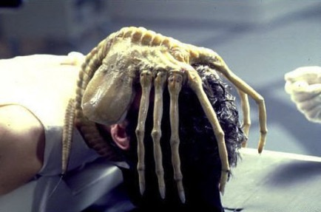
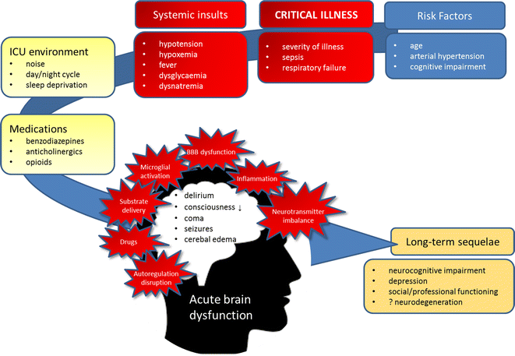
Houston We have a Problem
Cerebral
Sepsis related encephalopathy serious/poorly defined
Associated with high morbidity and mortality
Disruption BBB leading to inflammatory mediators into brain
Microcirculatory dysfunction decreasing cerebral perfusion
Microglial cell activation which leads to negative mediators/ROS
Some studies show increase non-convulsive seizures in sepsis
Horror Movie Survival: In space, never answer a distress signal. No one has survived to send the message.

Slide 21

Taking Back the Ship
No specific treatment-focus on infection control and support
Consider minimizing sedation as able targeting specific titration end points
Consider shorting acting sedative agents
Limit secondary insult- fever, pain, metabolic derangement
Best practices- re-orientation, eyeglasses, sleep
Early mobilization
Notes:
Possible advantage of dexmedetomidine
Watch benzodiazepines

Slide 22

Dinner and a show
Gastrointestinal
GI system-working organ including own immune system
Mucosal layer handles digestion but also barrier
Decreased blood flow and permeability disrupt barrier
Gut flora- critical for development of GI mucosal immune system, maintenance of gut homeostasis, provides essential nutrients, microbe barrier
Affected by hypoxic injury, antibiotics, proton pump inhibitors, vasopressors or parenteral feeding
Ileus, GI bleed, abdominal compartment syndrome
Notes:
Apotosis

Slide 23

Food For Thought
Primary treatment is prevent ongoing injury
Stress ulcer prophylaxis high risk bleeding
High risk- Mechanical vent, coagulopathy, recent GI bleed
Consider PPI or H2 blockade…but
PPI and C. diff association
Recent retrospective study shows distinct H2 advantage
Enteral feeding preferred – maintain of gut integrity, prevent permeability, modulate /attenuate inflammatory and metabolic response
Lilly CM, et al, Comparative Effectiveness of Proton Pump Inhibitors vs Histamine Type 2 Receptor Blockers for Preventing Clinically Important Gastrointestinal Bleeding During Intensive Care: A Population-Based Study.. Chest. 2018 Sep;154(3):557-566
Notes:
MV> 48 hours, GI bleed within 1 year
EAST-TBI and burns
Balance mesenteric blood flow

Slide 24
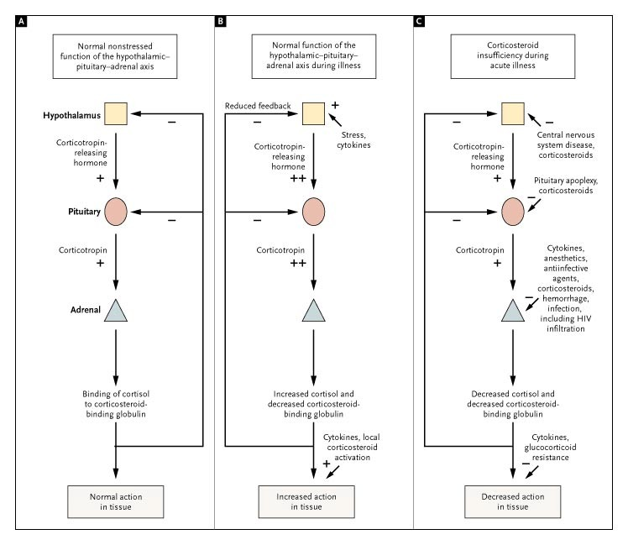
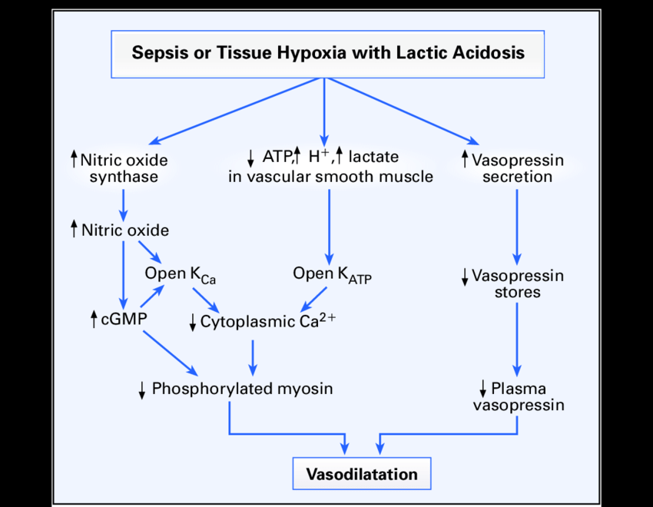
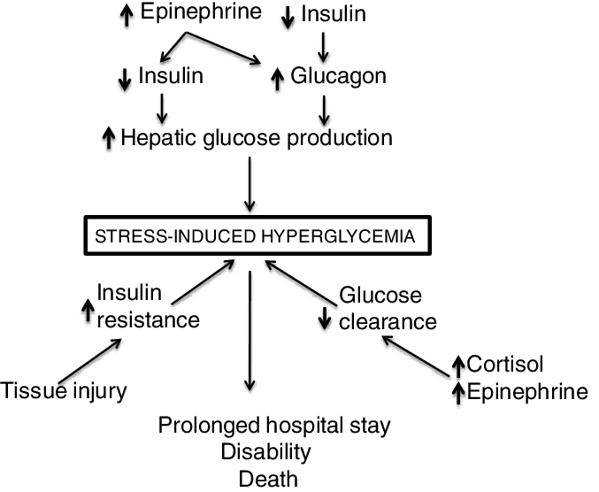

Killer Pathophysiology
Endocrine
Know corticosteroid insufficiency associated with critical illness
Multifactorial- pituitary injury, cytokine direct inhibition
Depletion, decreased synthesis of vasopressin
Downregulation of vasopressin receptors
Hyperglycemia known entity in critical illness
Multifactorial- insufficient insulin secretion to overcome the hyper-glycemia of counter-regulatory hormones and insulin resistance
Horror Movie Survival: If you kill a monster, never ever check to see if it’s really dead

Slide 25

The Final Cut
Consider IV hydrocortisone if unable to maintain HD stability with fluids/pressors
ADRENAL/APROCCHSS trial
Consider adding vasopressin to pressor refractory shock
Consider blood glucose management in ICU sepsis patients to maintain blood glucose < 180

Slide 26

Questions?
Horror Movie Survival: Avoid all summer camps, cabins in the woods, hostels, small towns in Maine and this family

